Slide 1
Structural Design Pattern: Decorator
by
Jyothikiran Nandanamudi
Gopi Krishna Swargam
Junaid Sidrah
Alsofyani, Mohannad Eida M

Slide 2
Decorator Design Pattern
Decorator pattern is a structural pattern which is used, when there is a need of adding new functionalities to an existing object without altering its structure.
This pattern is mostly preferred to extend or modify the behavior of an instance at runtime.
In general inheritance is used to extend the abilities of a class. But unlike inheritance, we can choose any single object of a class and modify its behavior leaving the other instances untouched.
In implementing a decorator pattern, we construct a wrapper around the object by extending its behavior.
The wrapper will do its job before or after and delegate the call to the wrapped instance.
We can use the decorator pattern when we just want to give some added responsibility to our base class. This design pattern is a great alternative to a sub‑classing feature for extending functionality with some added advantages.

Slide 3
Design of decorator pattern
It starts with an interface, which creates a blue print for the class which will have decorators.
This interface is implemented with minimum basic functionalities.
Then an abstract class is created which contains an attribute type of interface.
The constructor of this class assigns the interface type instance to that attribute. This class is the decorator base class.
We can extend this class and create as many concrete decorator classes.
In this decorator design pattern the binding of method and the base instance happens at runtime based on the object passed as parameter to the constructor.

Slide 4
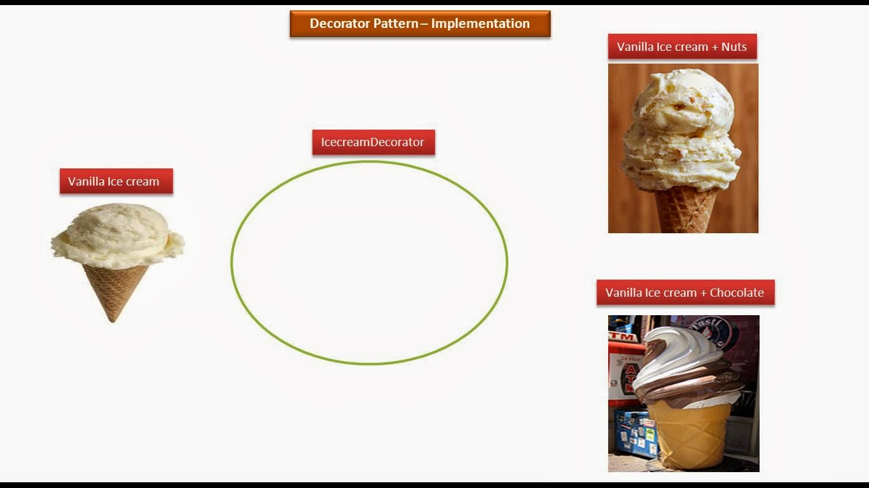
Ice Cream with toppings is an example of decorator pattern

Slide 5
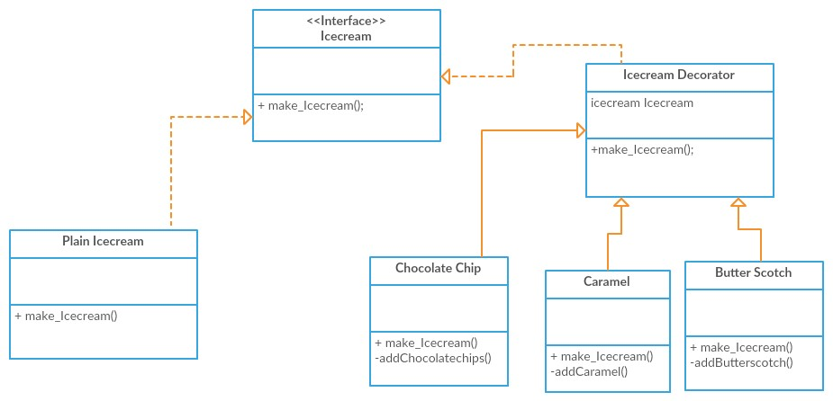
UML Diagram

Slide 6
Sample Code
Icecream.java
Baseicecream.java
Icecreamdecorator.java
Butterscotch.java
Caramel.java
Chocolatechips.java
Testdecorator.java

Slide 7
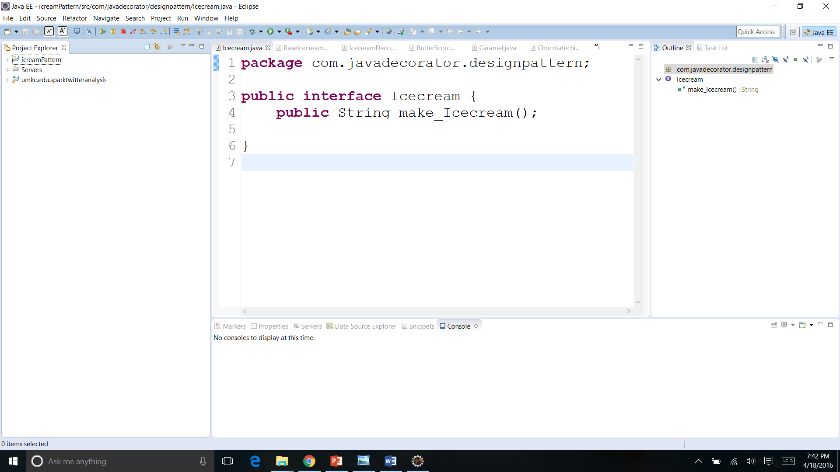
Interface of an Ice cream

Slide 8
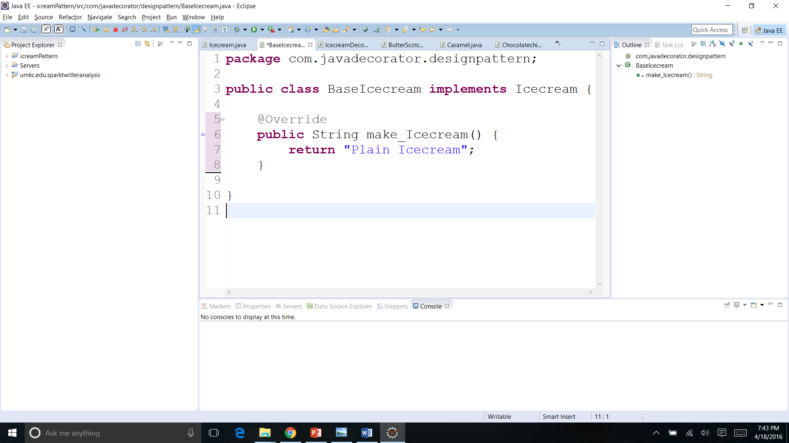
Implementation of Interface: Base case where toppings are added

Slide 9
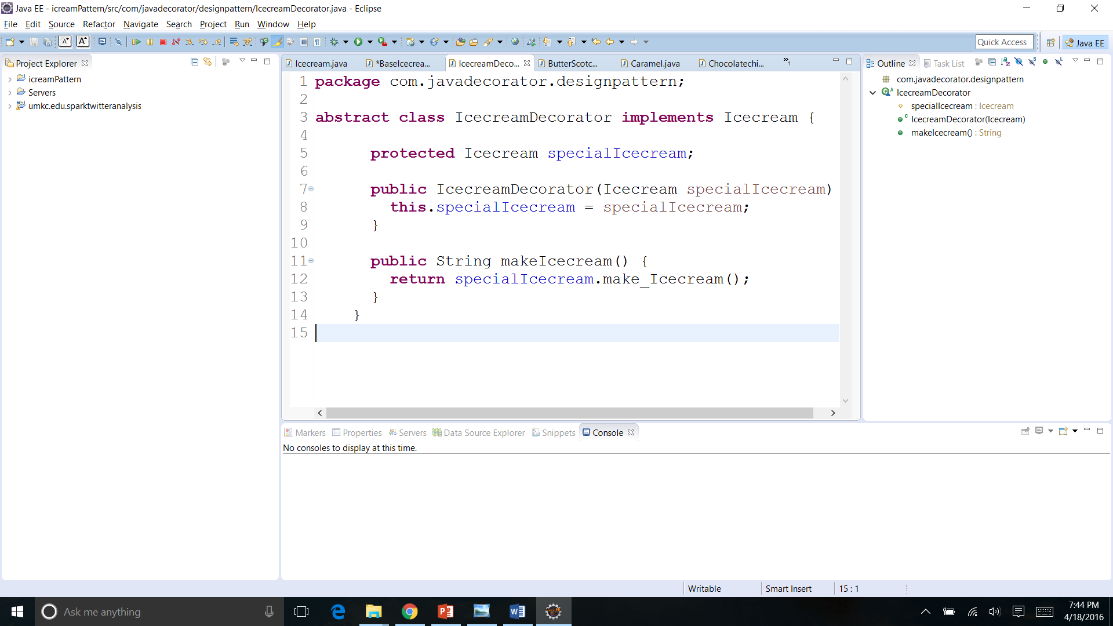
Decorator class: Contains attributes for the type of interface

Slide 10
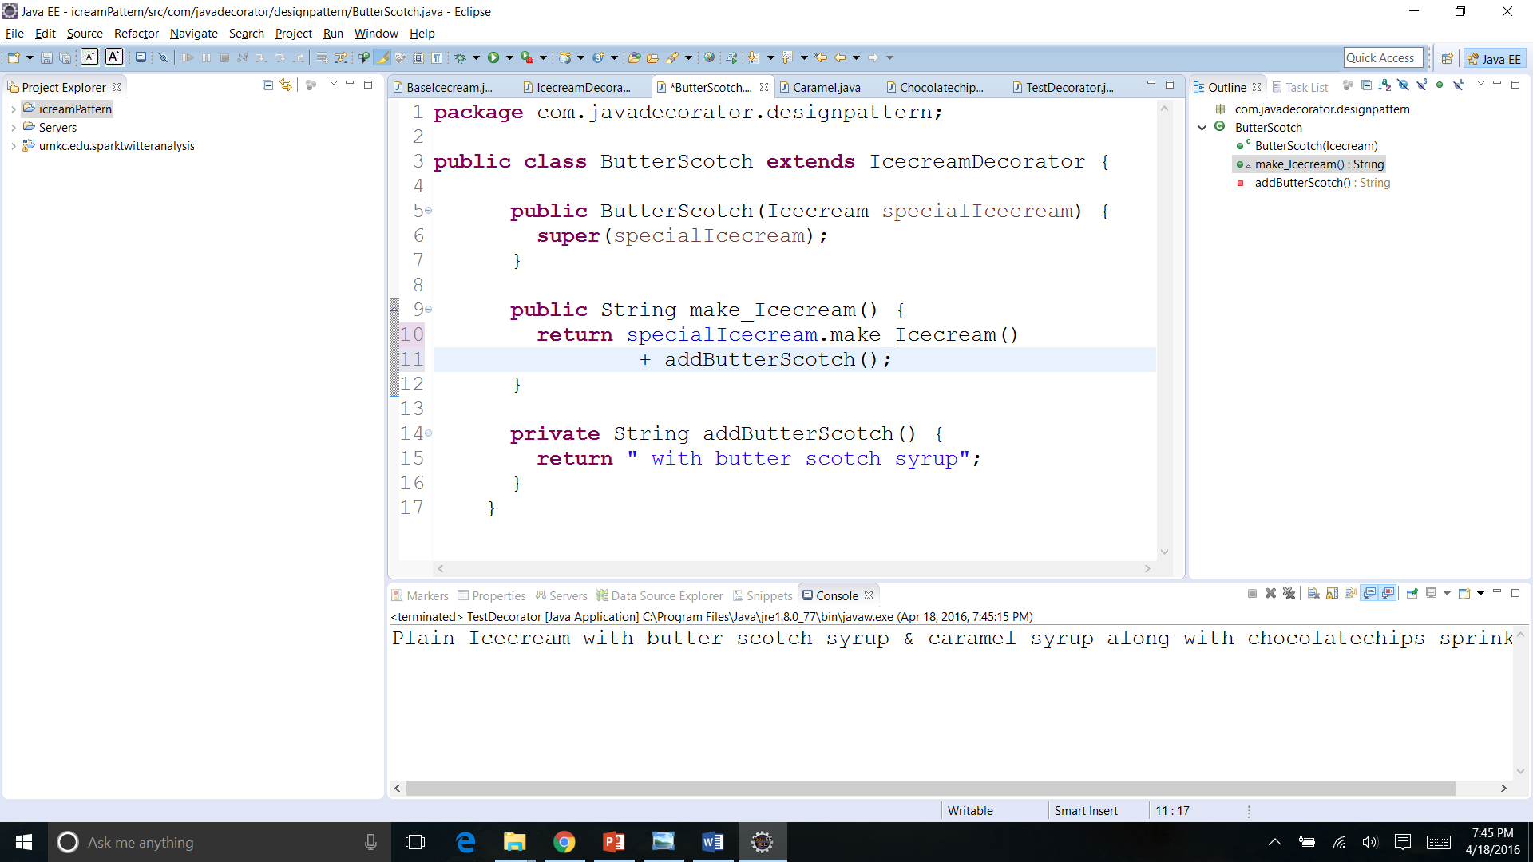
Decorator 1 : Butter Scotch Syrup

Slide 11
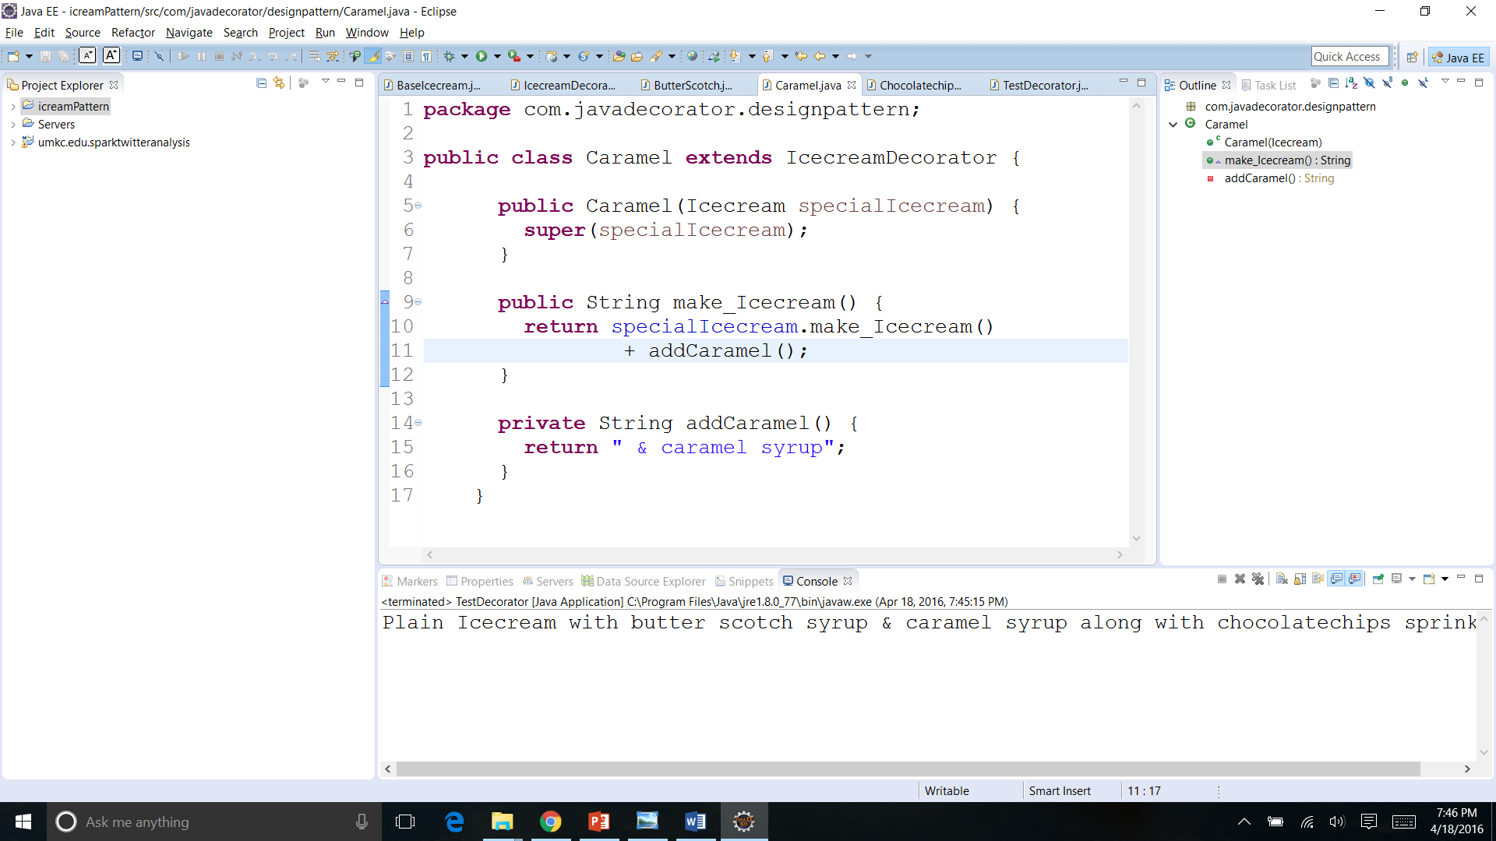
Decorator 2 : Caramel Syrup

Slide 12
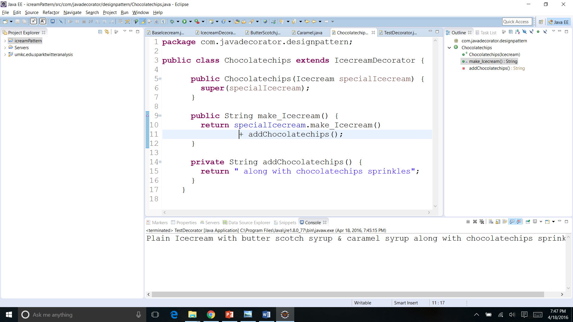
Decorator 3 : Chocolate chips Sprinkles

Slide 13
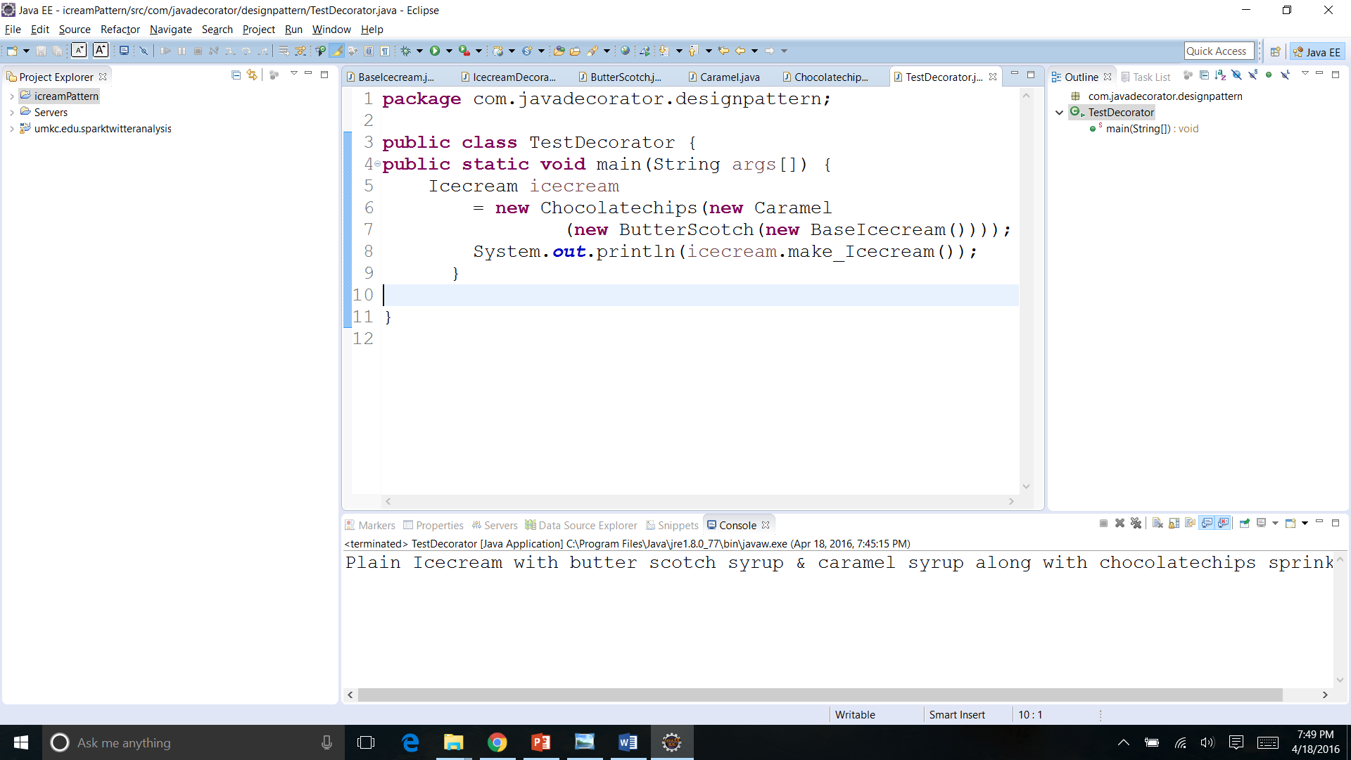
Ordering the Ice cream

Slide 14
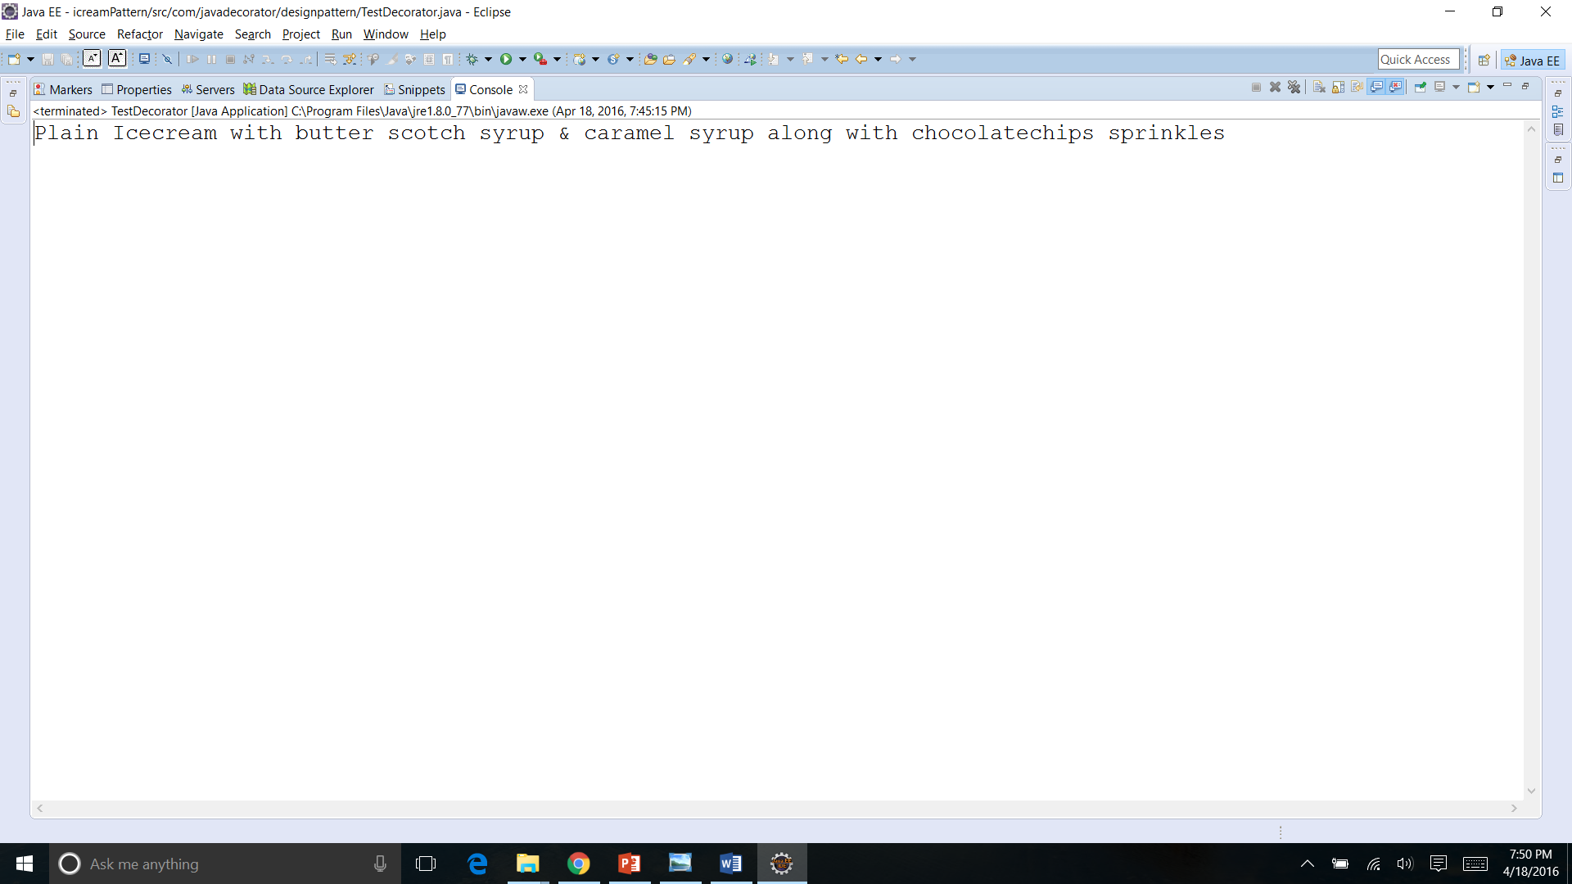
Served

Slide 15
